Slide 1
Digital Security and Forensics AICT006-4-2-DSF Version 2
Data Hiding and Obfuscation

Slide 2
Topics & Structure of The Lesson
Data Hiding and Obfuscation Methods
Water Marking
Steganography

Slide 3
Learning Outcome
At the end of this topic, You should be able to:
Discuss on Data Hiding and Obfuscation Methods
Explain Water Marking
Discuss Steganography

Slide 4
Key Terms You Must Be Able To Use
If you have mastered this topic, you should be able to use the following terms correctly in your assignments and exams:
Data Hiding and Obfuscation Methods
Watermarking
Steganography

Slide 5
Modules Objectives
Study obfuscation methods
Encoding
Encryptions
Discover various file analysis

Slide 6
Lecture Content
Data Hiding and Obfuscation Methods
Water Marking
Steganography

Slide 7
Methods
Obfuscation using Encryption
Obfuscation through Tunneling
Covert Channels
Watermarking and Stenography
Hiding File Contents

Slide 8
Hiding by Encryption
Private Key Data Hiding
RC2, RC4, DES, 3DES, AES
Public key data hiding
RSA, DSA, FIPS186-2, EIGamal
Hashing
MD5, SHA-1
Encoding
Hex, Base-64, ASCII, UTF-16

Slide 9
Ways to crack the key
Passing password registration
Key strings (vocab)
Medabots, final countdown, mypassword
Dictionary
A, abilities, ability, able … yourselves, zero, zip, zoo
Brute Force
Unlimited guessing
Definition: it uses precompiled list of options and only try complete options which are likely to work.
E.g. Access to a secret club requires knowing the owner's name, you guess "Rob" or "Jake" rather than "computer"
Definition: Attempts to determine a secret by trying every possible combination. E.g. Given a combination lock which requires three numbers to be taken in sequence, you try every possible combination - e.g., First 1-2-3, then 1-2-4.

Slide 10

Hiding by Hash
A wants to send message to B.
A need B’s Digital Certificate which contains public key to encrypt the message before sending
B need private key to decrypt the message.
DC
A
8$oN
Hi B
B
DC
B’s Public key
Private key

Slide 11
Encoding
ASCII Encoder. Tool to convert ASCII (binary, octal, decimal, hexadecimal) automatically. ASCII (American Standard Code for Information Interchange) is the most used character coding system.
It defines 128 characters numbered from 0 to 127 and coded in binary on 7 bits from 0000000 to 1111111.
Each letter assigned a number.
Ex: ASCII Code for M = 77

Slide 12
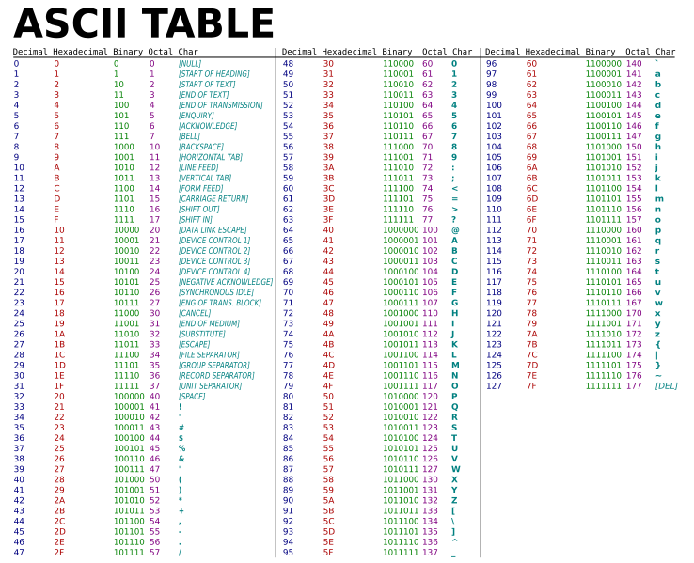
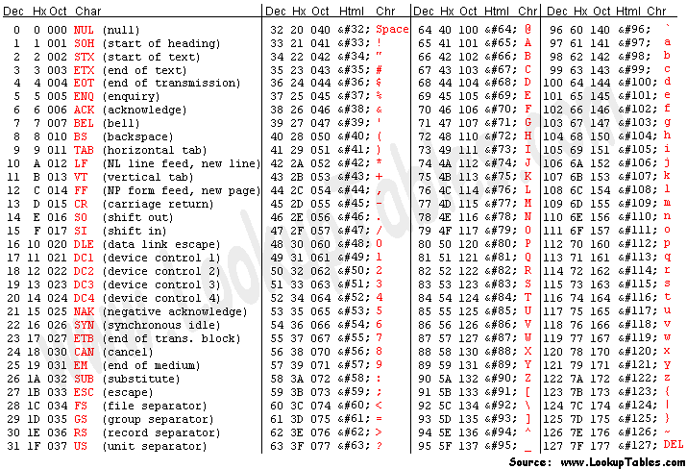
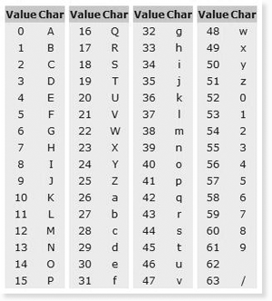
Encoding
Dec, Hex, Base64, Binary Basis

Slide 13
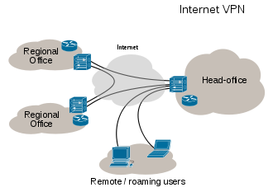
Hiding by Tunneling
In computer networks, a tunneling protocol is a communications protocol that allows for the secure movement of data from one network to another

Slide 14
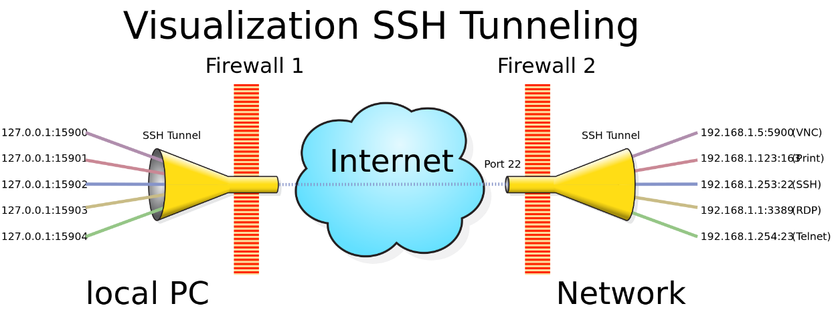
Hiding by Tunneling
A SSH tunnel consists of an encrypted tunnel created through a SSH protocol connection. A SSH tunnel can be used to transfer unencrypted traffic over a network through an encrypted channel.
It is identified as a useful method available for transmitting information via an unencrypted protocol such as IRC, VNC, HTTP etc.

Slide 15


Hiding by file signature
Simple search cannot find the deleted files
Use Deep scan (byte-by-byte)
Some attackers change file name, extensions. E.g. missed files

Slide 16
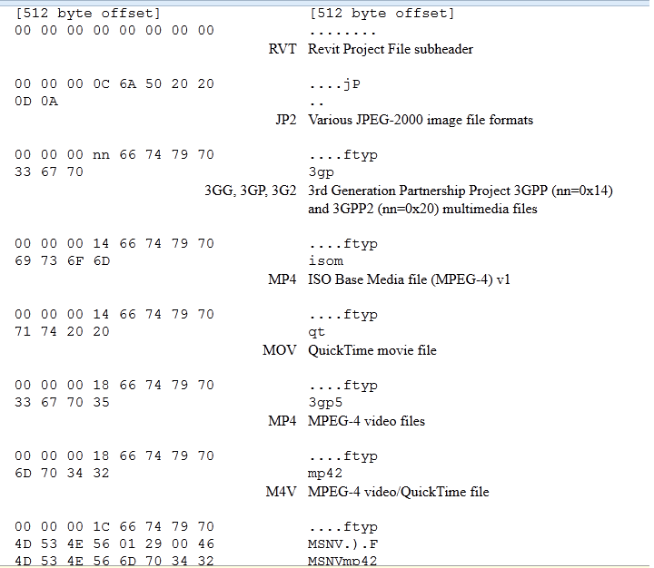
File Signatures

Slide 17
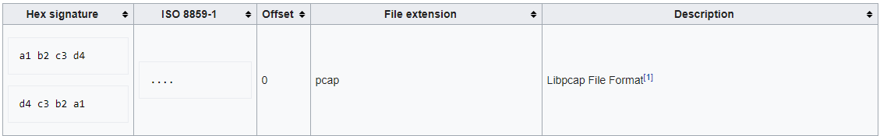
File Signatures

Slide 18
Quick Review Question
Distinguish Steganography and Water marking?

Slide 19
Watermarking vs. Stenography
Invisible watermarking refers to adding information in a video or picture or audio as digital data.
Steganography is changing the image in a way that only the sender and the intended recipient is able to detect the message sent through it. It is invisible, and thus the detection is not easy.

Slide 20
Summary
Obfuscation through Tunneling
Covert Channel
Watermarking and Stenography
Hiding File contents

Slide 21
Q & A

Slide 22
What we cover next
Watermarking/Stegano
SSL, SSH
Digital Signature
Symmetric/Asymmetric
Hash vs MD5 – Hashing algorithms

